Slide 1
CME-Type II Event Analysis
2014/12/05
Group Mentor : Nat Gopalswamy
Zavkiddin Mirtoshev
Bobosher Bakhriddinov
Farhod Shokirov
Salokhiddin Ergashev
Sherzod Sayfiyev
Abdujalol Safarov
Sahan Liyanage
COSPAR CBW, 2024, SAMARKAND

Slide 2
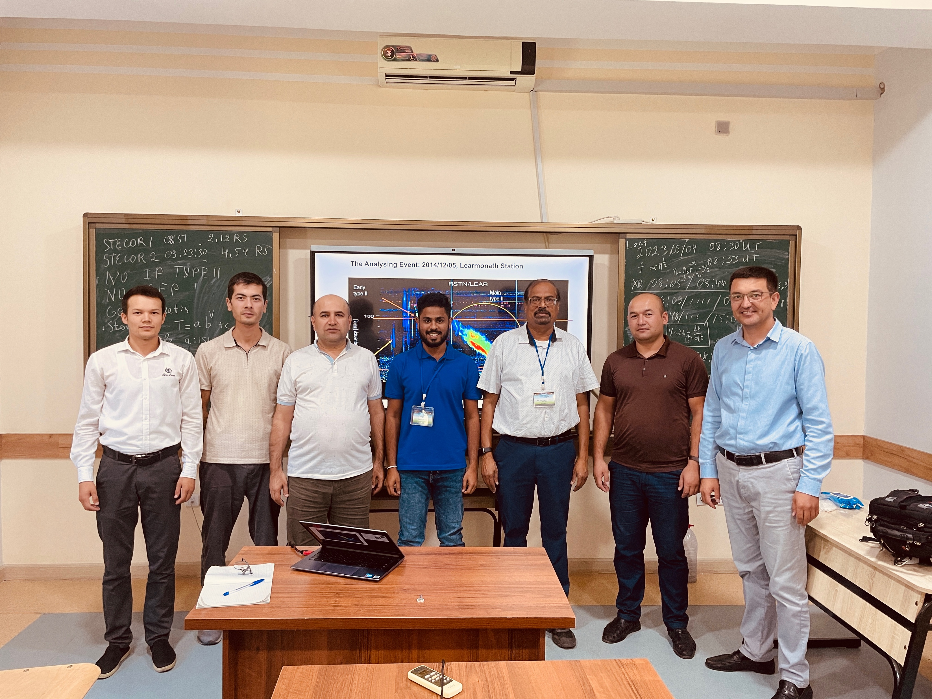
Our Group

Slide 3
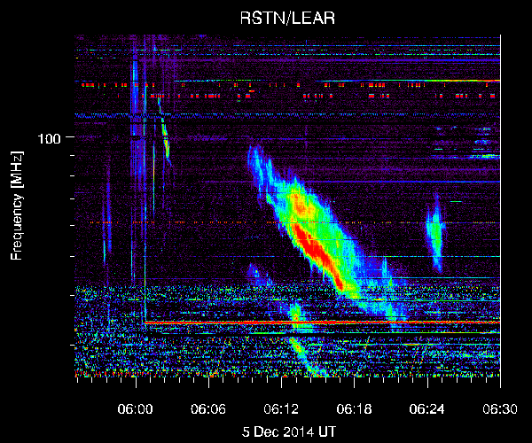
The Analysing Event: 2014/12/05, Learmonath Station
Type II
06:01:48
06:02:49
Early type II
Main type II
type III
bursts

Slide 4
 | Starting | Ending
Frequency (MHz) | 129.06 | 84.81
Time (UT) | 06:01:48 | 06:02:53

Slide 5
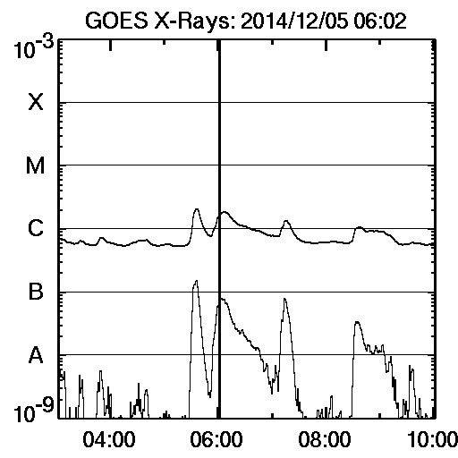
Early Type II
C1 Flare

Slide 6
Early Type II Burst
 | Starting | Ending
Frequency (MHz) | 129 | 85
Time (UT) | 06:01:48 | 06:02:53
From the SDO Image
 | Time | Height
Frame 1 | 06:00:07 | 1.24Rs
Frame 2 | 06:02:08 | 1.29Rs

Slide 7
Shock Formation Height using the SDO image of the CME
Notes:
7

Slide 8
Evolution of the shock in SDO/AIA Running Difference Images

Slide 9
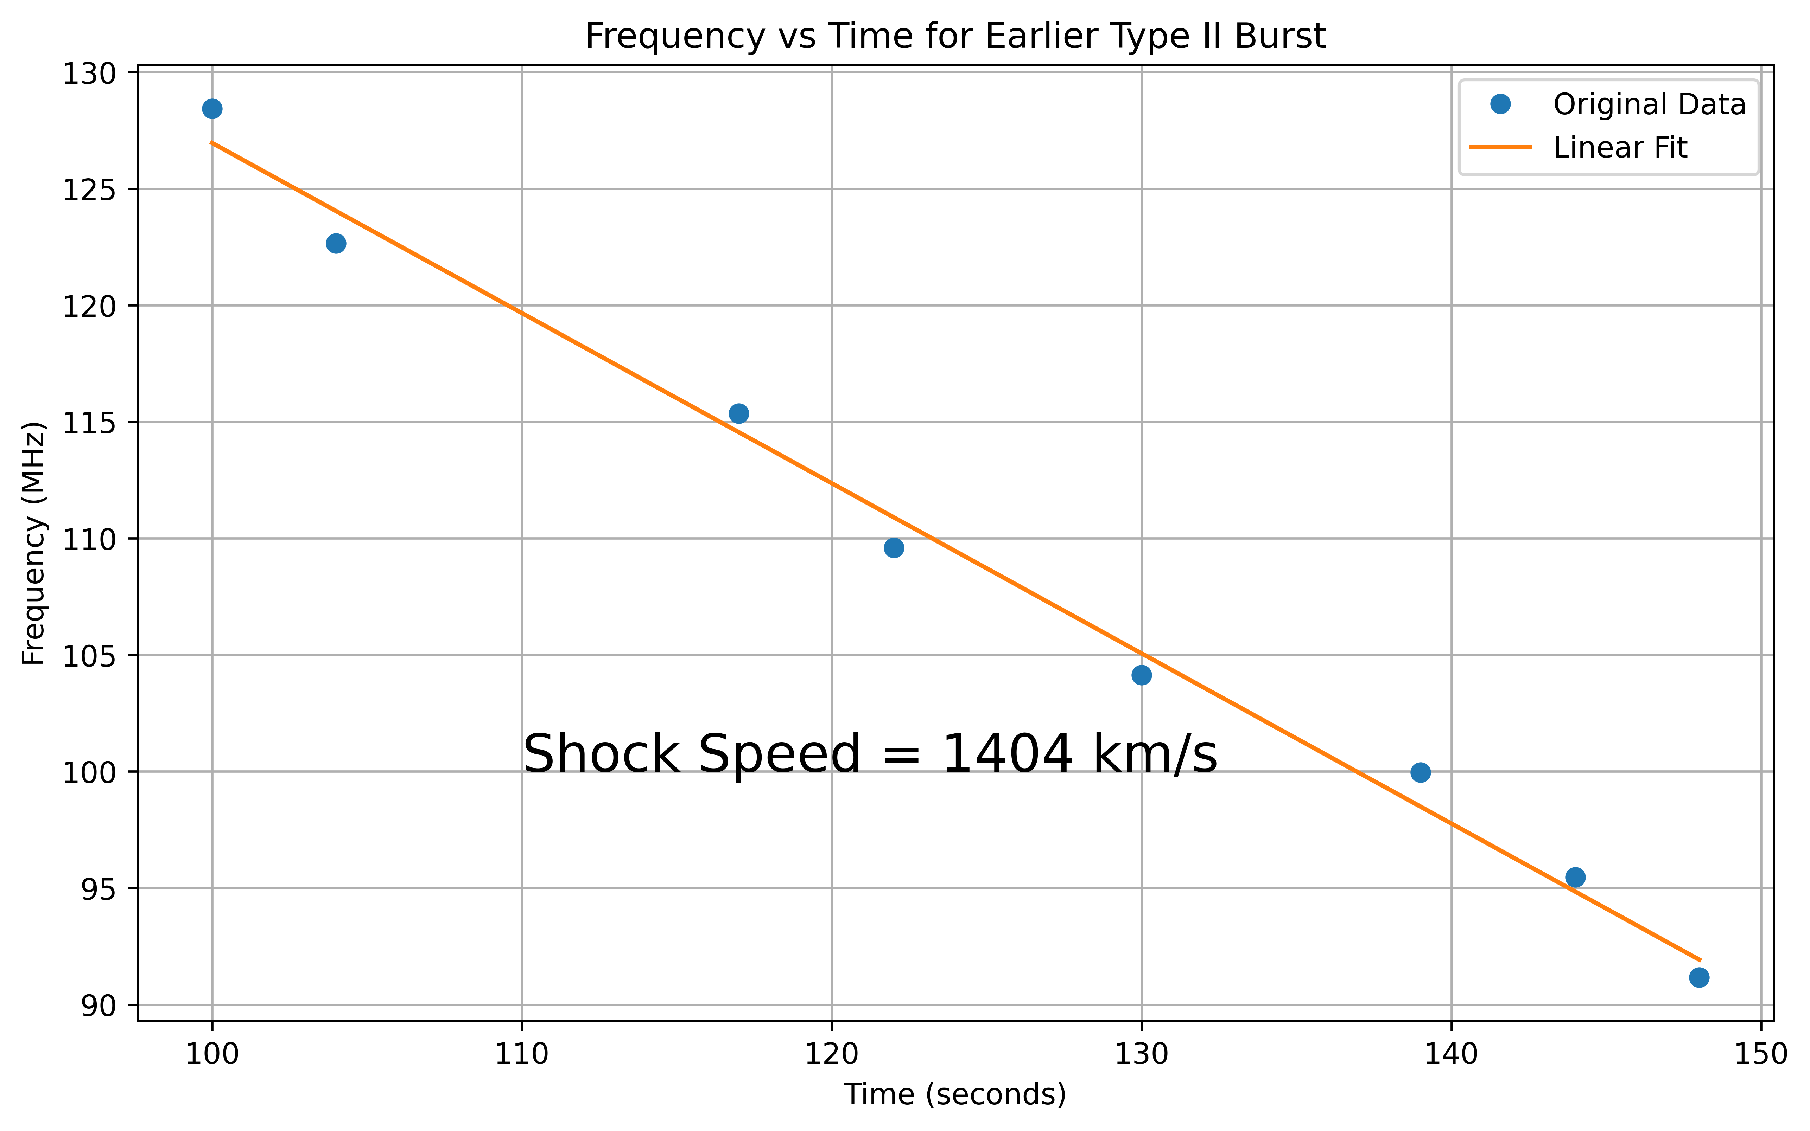
The shock speed from the using the frequency vs time plot was found to be 1404 km/s.
Therefore, the height -time shock speed is not consistent with this speed.

Slide 10
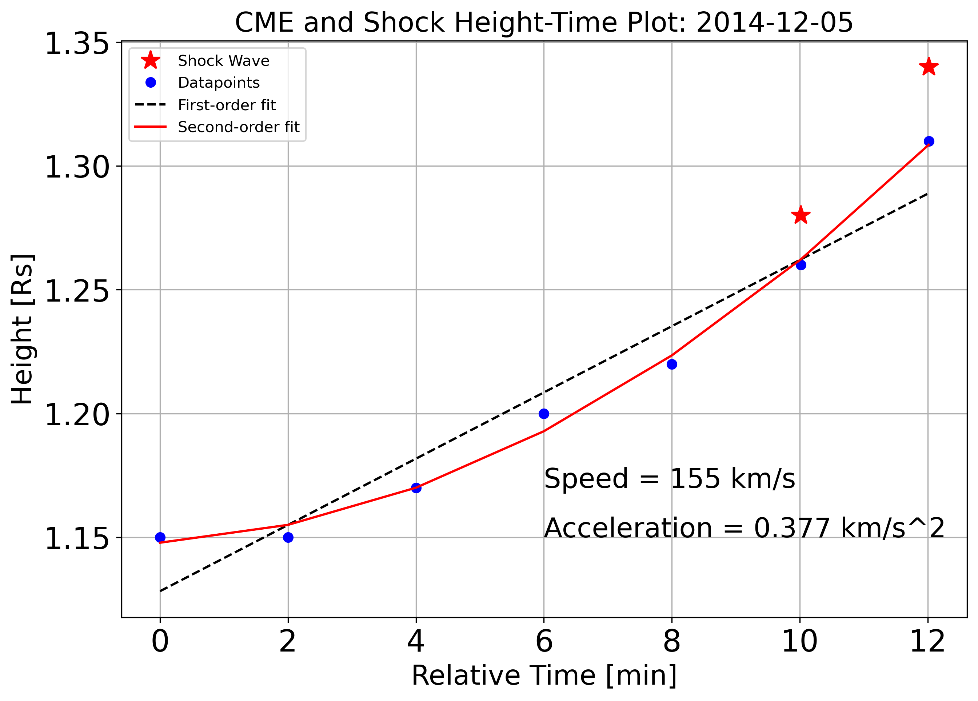
(linear)
Equation:
CME and Shock Height-Time Plot for the Early Type II Radio Burst.
Shows the gap between the CME and the Shock

Slide 11
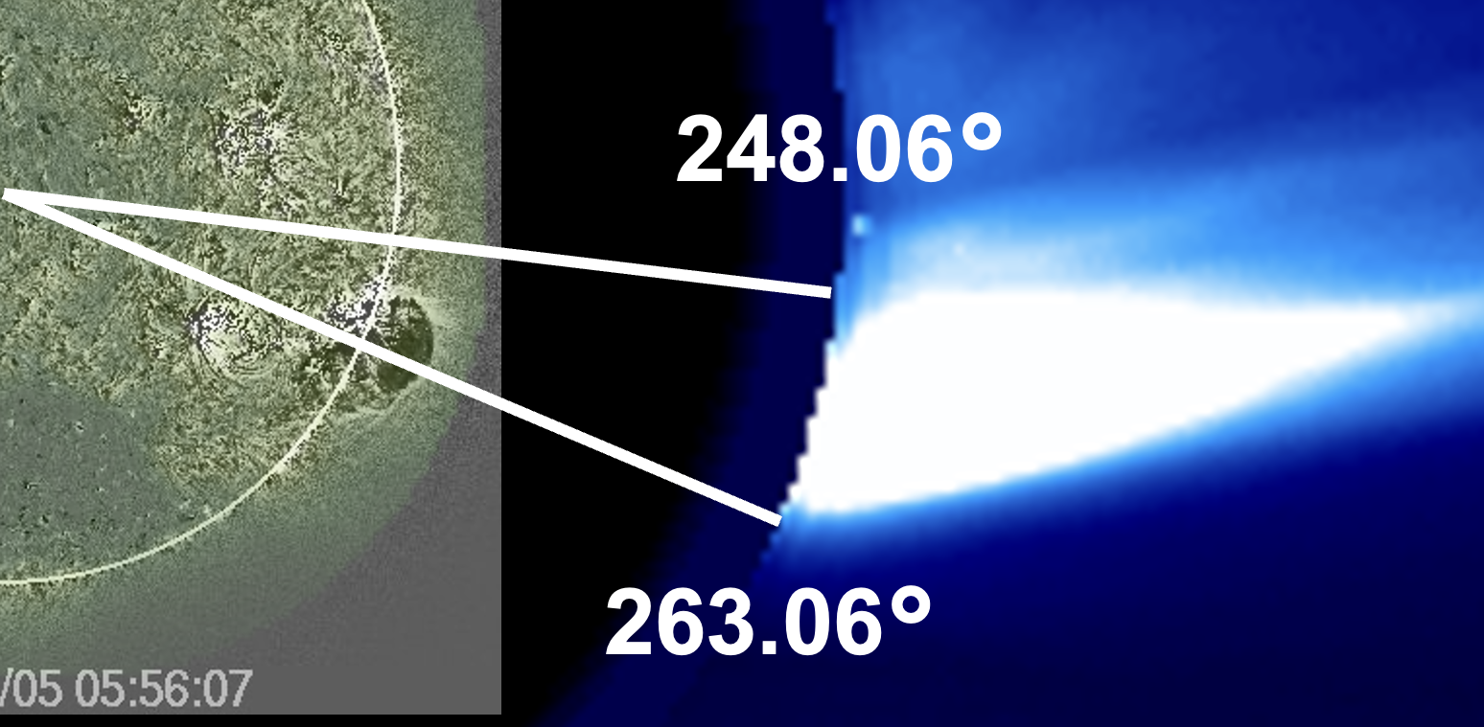
Shock wave through the streamer
SDO/AIA
LASCO C2
Streamer
248.06°
The shock is traveling through streamer. The alfven speed of the streamer region is low, that would help to strengthen the shock. This could be the reason to the first type II radio burst.
Also L may be small (the streamer section transited by the shock)
263.06°
CME

Slide 12
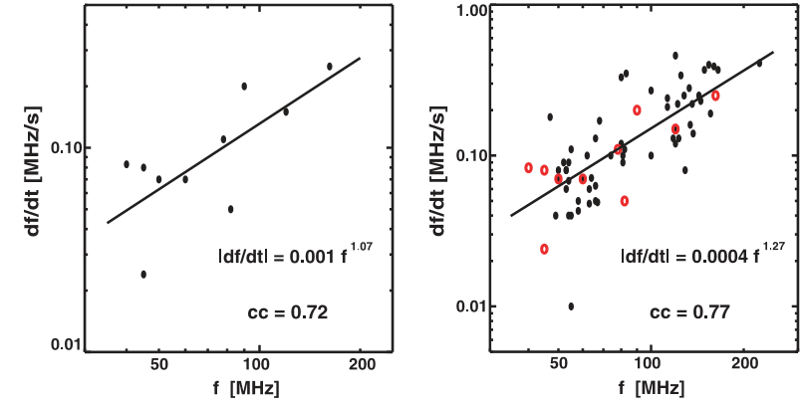
df/dt = 4×10⁻⁴f^{1.27}
Early type II drift rate is higher than the distribution
- looks like an outlier
Gopalswamy et al. 2009

Slide 13
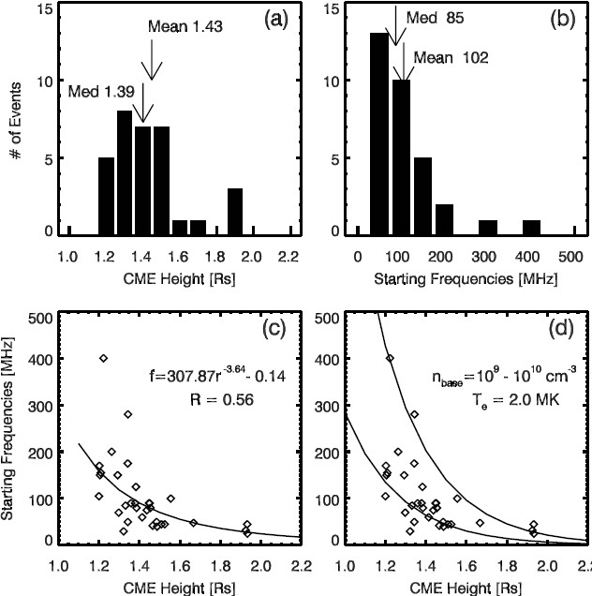
Where in the Corona do shocks form? Statistics
CME ht @
Type II onset
Type II starting
frequencies
32 Type II bursts
STEREO CMEs
n = 1.2x10⁸ cm⁻³
model:
exponential fall off
of n with a
hydrostatic scale
height
Type II heights
indicate overall
density decline
with height
Gopalswamy et al. 2013 AdSR

Slide 14
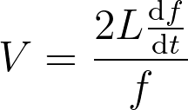
Reverse Calculation for Finding Alpha
Slightly higher from 1.29

Slide 15
Discussion
CME is mostly expanding northwards instead of expanding radially.
coronal hole
A corona hole can be seen in the southern part of the sun.
Since the magnetic pressure is higher in the coronal hole, it pushes CME to the northward.

Slide 16
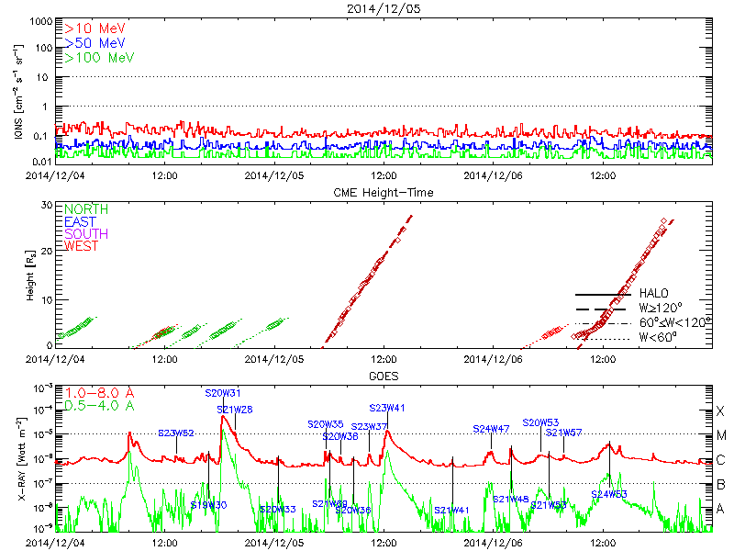
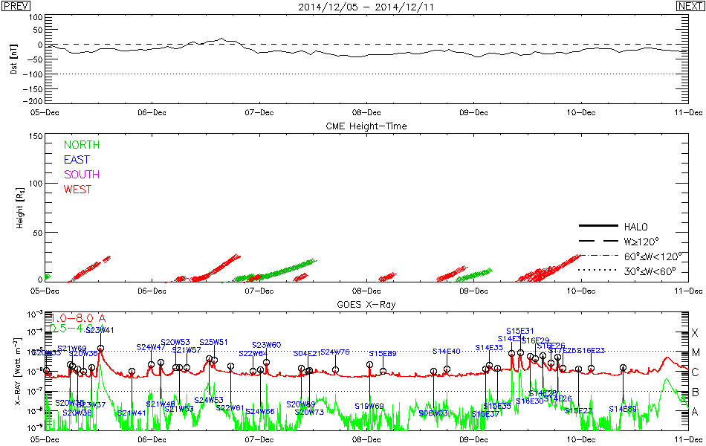
Associated SEP and Geomagnetic Storms with the CME
No SEP event
No geomagnetic storm
Our CME
There were not any SEP event and Geomagnetic storm associated with the CME.

Slide 17
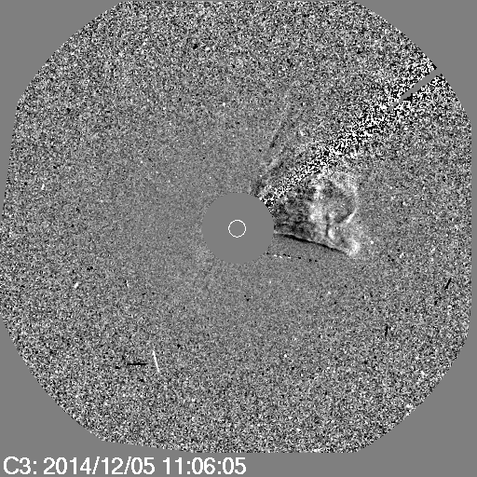
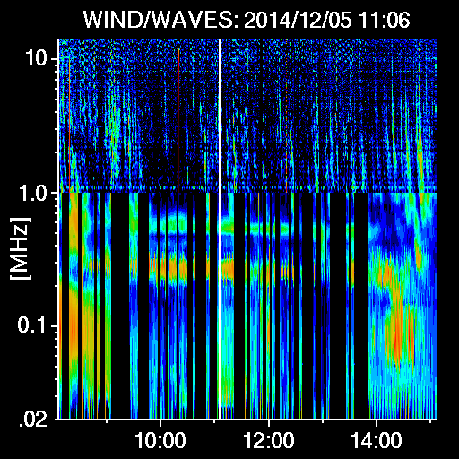
CME is driving a Interplanetary Shock
IP Type II
Starting Time of the Burst: 07:30, 12/05
Ending Time of the Burst: 01:54, 12/06

Slide 18
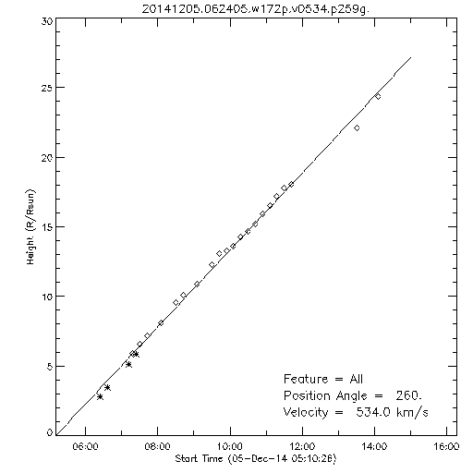
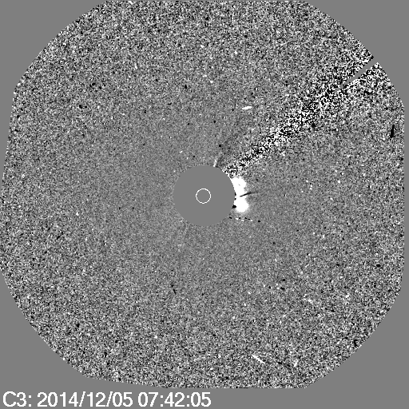
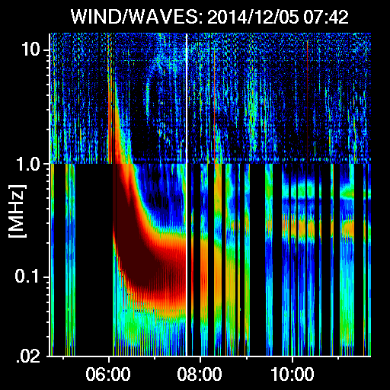
First appearance of the Interplanetary Type II Shock
Shock Formation Height = 7.17Rs

Slide 19
The Type III burst is starting near to the solar surface(metric region), then it is expanding to the interplanetary medium.
IP Type II
06:00
06:30
07:00
07:30

Slide 20
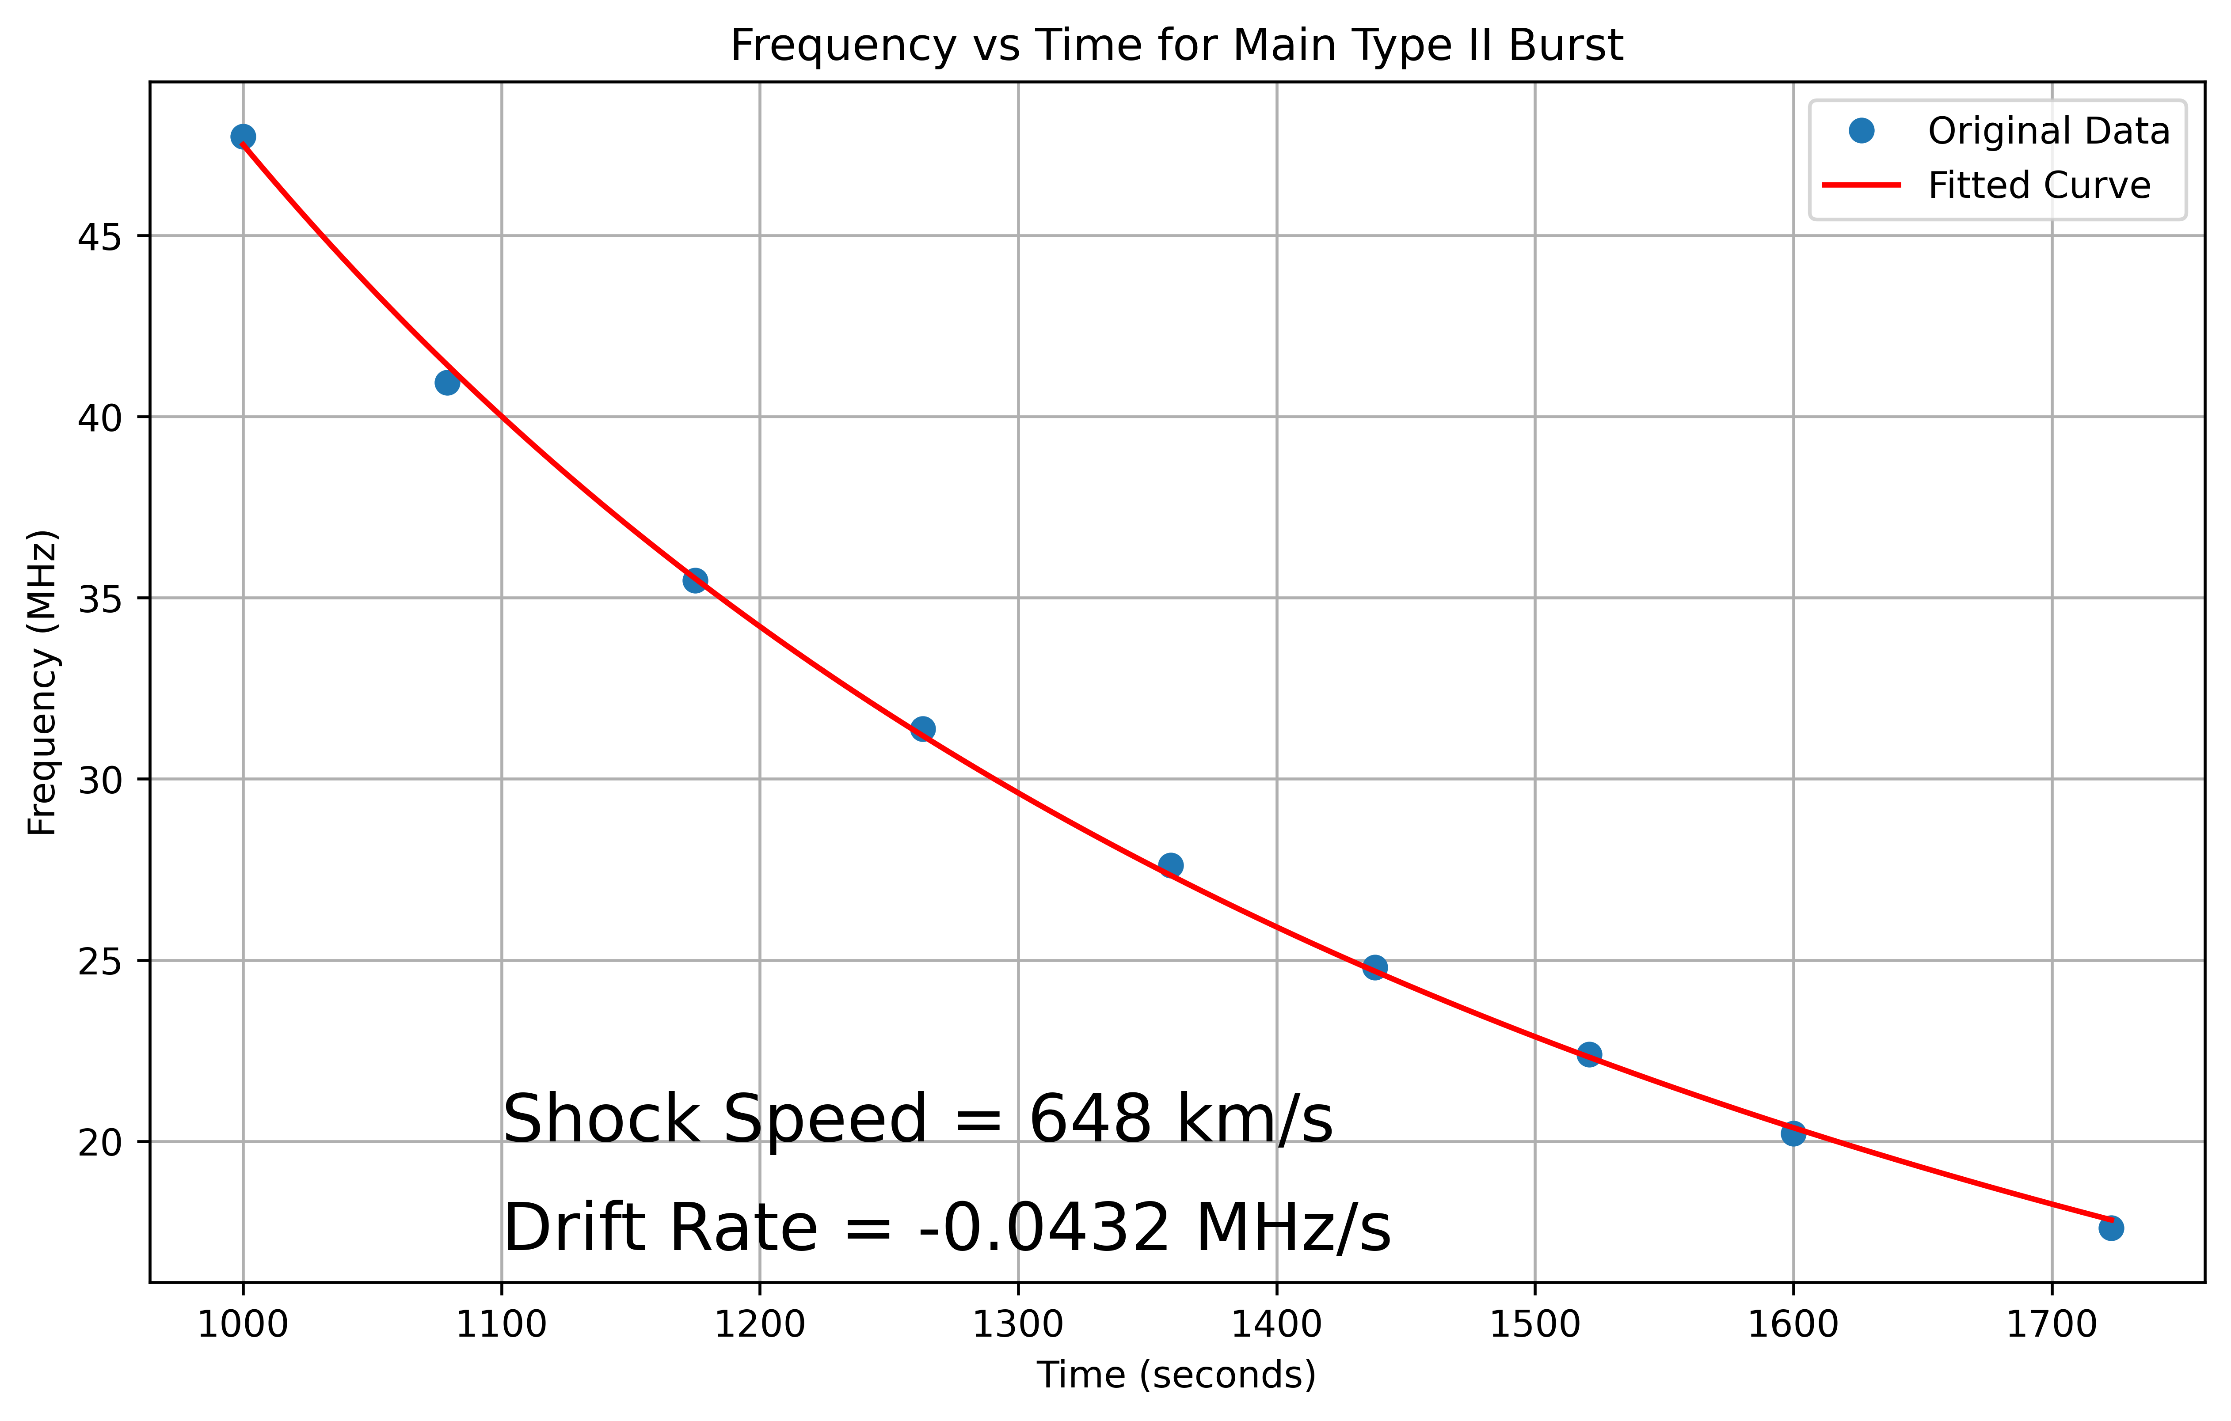
Drift Rate and Shock Speed Analysis for the Metric Type II Radio Burst

Slide 21
The Magnetic Field Measurements from the Type II Radio Burst
UPF
LPF

Slide 22
The Magnetic Field Measurements from the Type II Radio Burst
Time | UFB | LFB | BDW | x | MA | VA | B
6:12:45 | 37.64 | 31.63 | 0.1900 | 1.4161 | 1.3260 | 489 | 0.7883
6:13:12 | 34.86 | 30.21 | 0.1539 | 1.3315 | 1.2569 | 516 | 0.7943
6:13:34 | 34.15 | 29.15 | 0.1715 | 1.3725 | 1.2901 | 502 | 0.7467
6:14:17 | 32.96 | 26.58 | 0.2400 | 1.5377 | 1.4287 | 454 | 0.6148
The Average Alfven Speed = 490 km/s
The Average Magnetif Field= 0.7361 Gauss

Slide 23
Summary of the Event – 2012/12/05
1. Earlier Type II
4. Main CME(Metric Type II)
 | Starting | Ending
Frequency (MHz) | 129 | 85
Time (UT) | 06:01:48 | 06:02:53
Shock Speed: 648 km/s
Drift rate: -0.0432 MHz/s
5. IP Type II
CME Speed: 540 km/s
2. Main Type II
6. No SEP Event
 | Starting | Ending
Frequency (MHz) | 94 | 32
Time (UT) | 06:12 | 06:19
7. No Geomagnetic Storm Event
8. Magnetic Field Measurements
Mean Ambient Magnetic Field: 0.74 Gauss
Mean Alfven Velocity: 490 km/s
3. Earlier CME
CME Speed: 155 km/s
Shock Speed: 1404 km/s
Drift Rate: 0.377 MHz/s

Slide 24
Conclusions – Event 1
There are 3 components in the event:
(i). Early Type II
(ii). Metric Type II
(iii). Interplanetary Type II
There was a class C1.8 X-ray flare.
There were no any SEP or Geomagnetic storm events observed.
Earlier Type II due to the CME is passing through a corona streamer driving a shock for a short time.
CME directed nowthward due to a corona hole in a southern region of the sun and let pass through the streamer.
Metric Type II due to the CME shock wave after passing the corona streamer.
Band splitting of the Metric Type II SRB used to estimate the magnetic field (0.74 Gauss).

Slide 25
CME-Type II Event Analysis
2023/05/04
COSPAR CBW, 2024, SAMARKAND

Slide 26
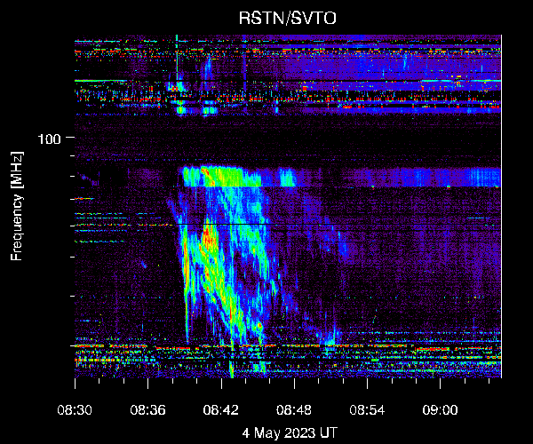
The Analysing Event: 2023/05/04, RSTN/SVTO
Type III Burst
 | Starting | Ending
Frequency (MHz) | - | -
Time (UT) | 08:09 | 08:16
Type IV
Type III
Type II Burst
H2
 | Starting | Ending
Frequency (MHz) | 70 | 15
Time (UT) | 08:37:40 | 08:51:16
H1
F
Type IV Burst
Type II
 | Starting | Ending
Frequency (MHz) | - | -
Time (UT) | 08:48 | 15:06

Slide 27
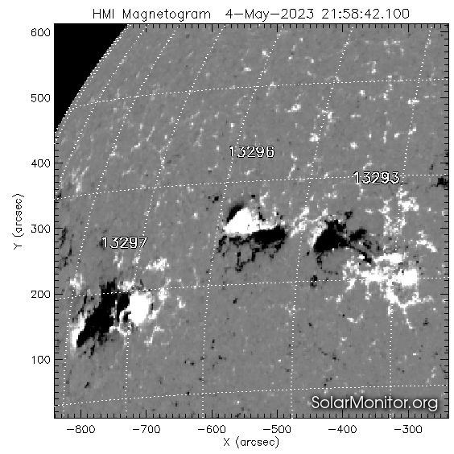
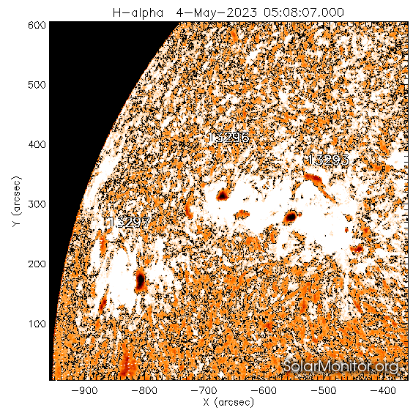
The Associated Active Region and Source Location
Associated active region : 13296
The source location : N17E43
There are two sunspots can be observed.

Slide 28
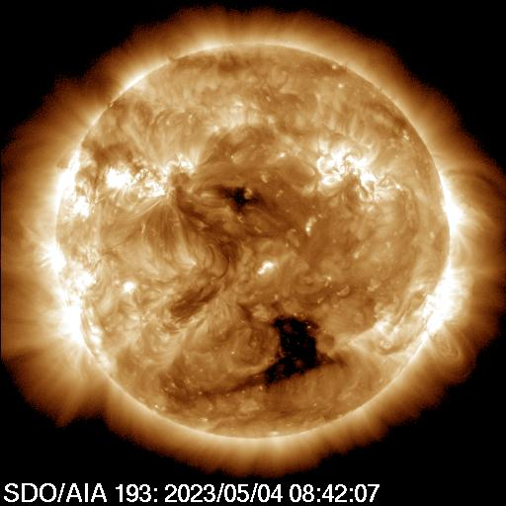
Flare Reigon EUV Observation

Slide 29
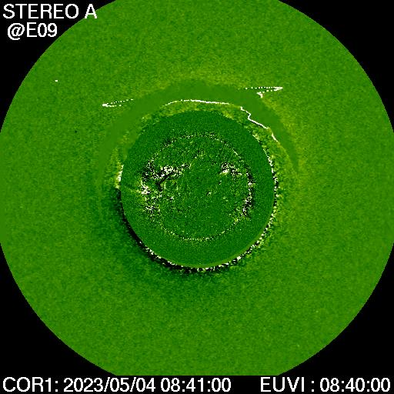
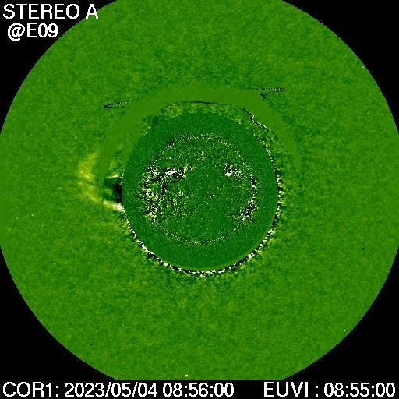
First Appearance of in STEREO COR1 and EUVI

Slide 30
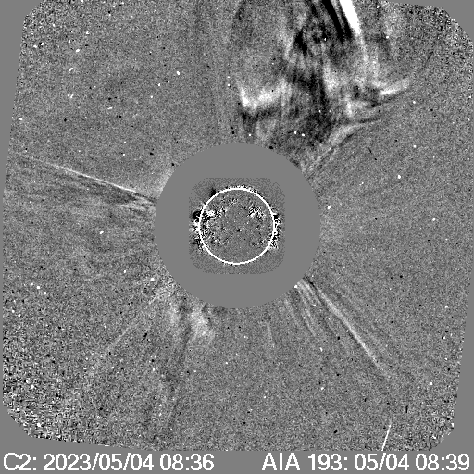
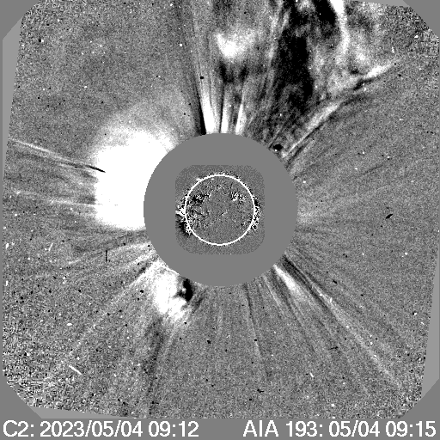
First Appearance in LASCO C2
Shock
CME
CME

Slide 31
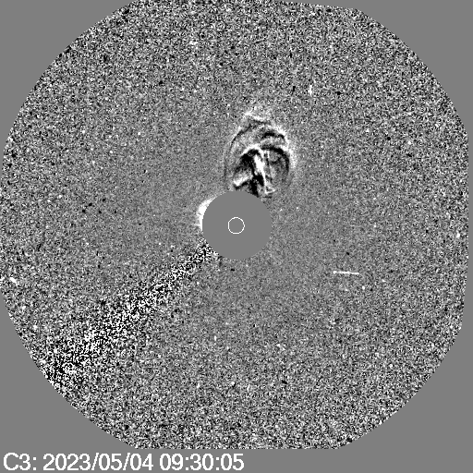
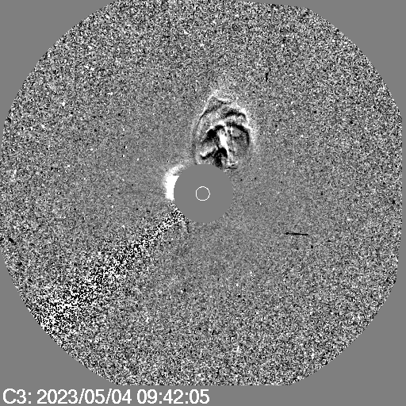
First Appearance in LASCO C3
CME
Shock
CME

Slide 32
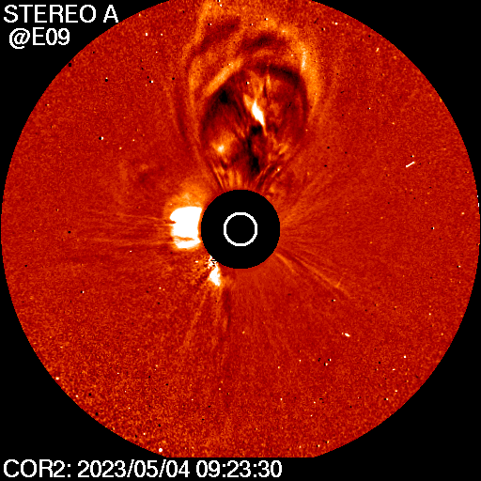
First Appearance in STEREO COR2
Shock
CME

Slide 33
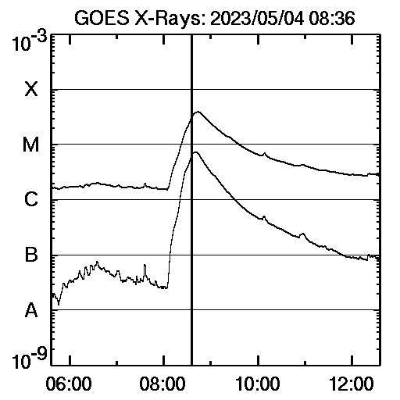
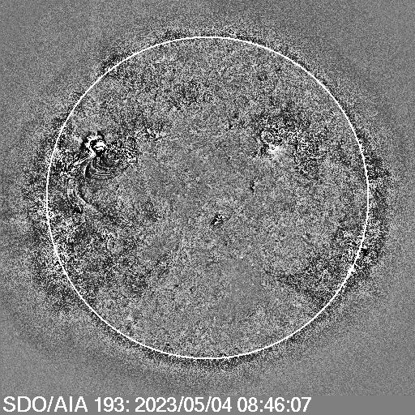
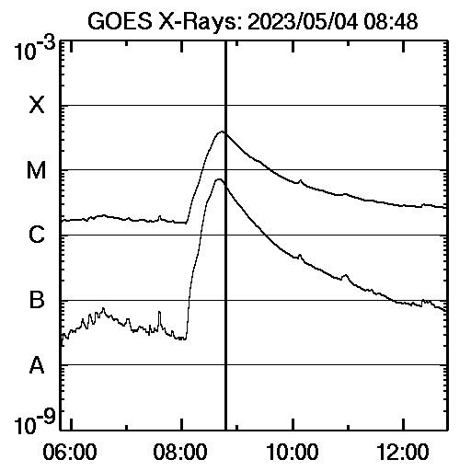
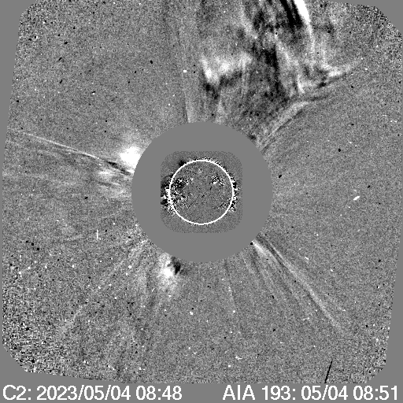
X-Ray GOES Observations
Start: 08:36 UT
Peak: 08:44 UT
Class: M3.9
End: 09:08 UT
First Occurrence of the Flare on GOES
08:36 UT
First Occurrence of the CME on C2
08:48 UT

Slide 34
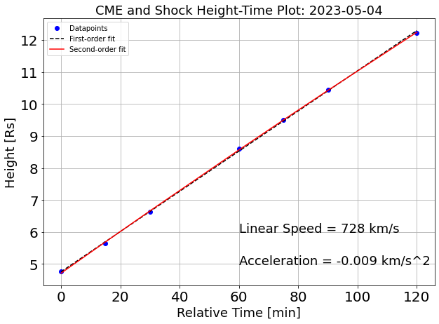
The Main Type II Burst Analysis-Shock Speed

Slide 35
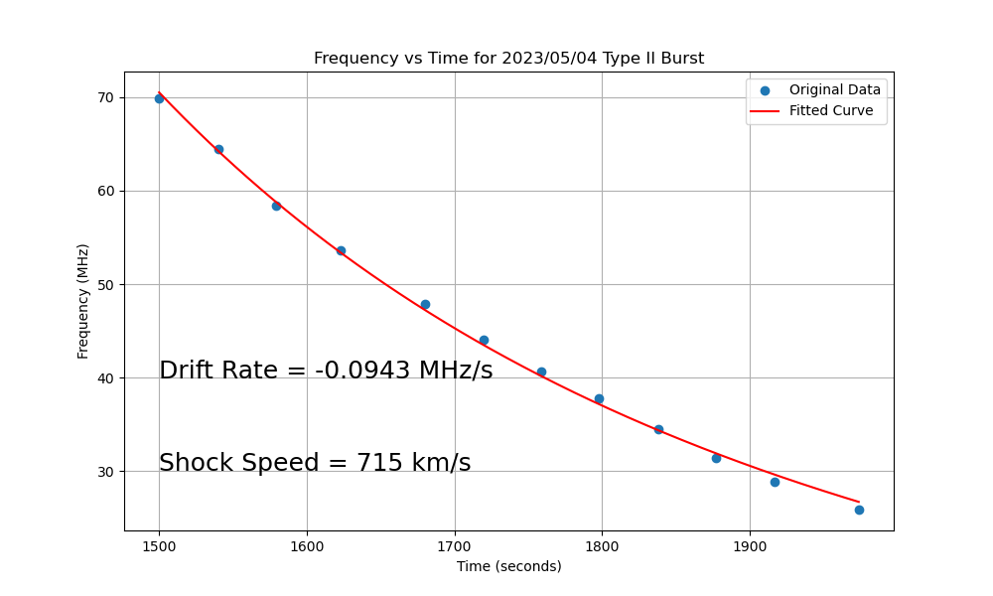
The Shock Speed from Frequency and Time Plot

Slide 36
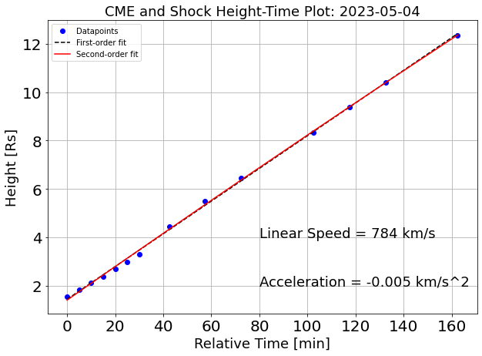
The CME Speed Analysis
Acceleration

Slide 37
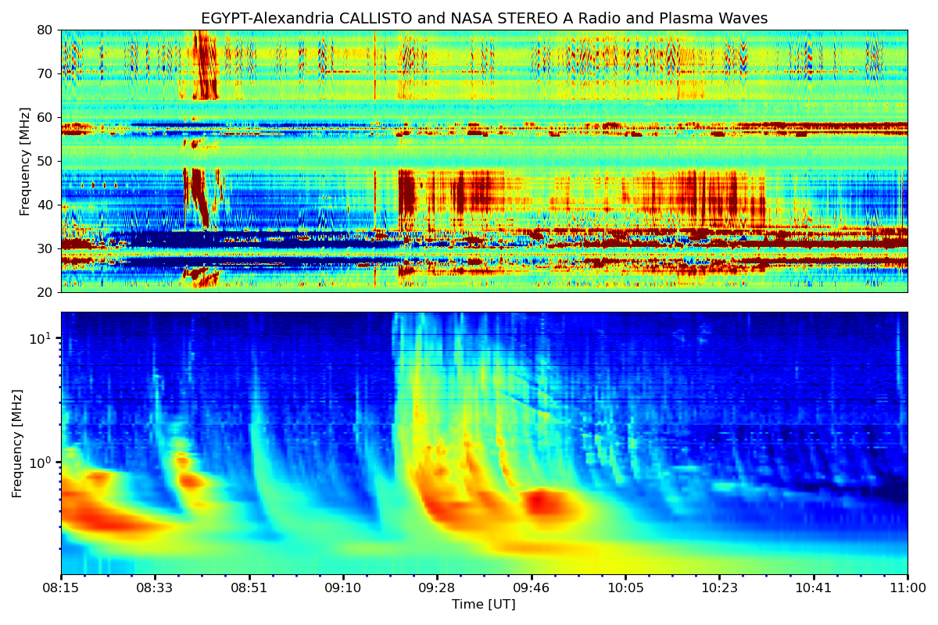
Interplanetary Type II Burst
Metric Type II 1
Metric Type II? 2
IP Type III
IP Type II

Slide 38
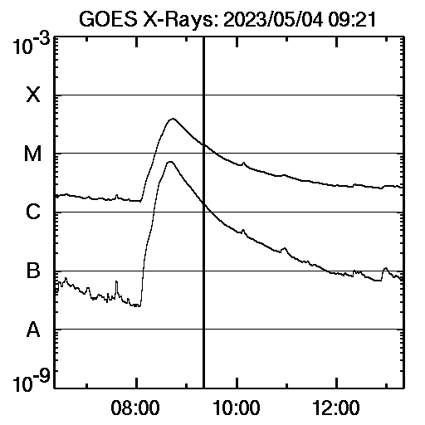
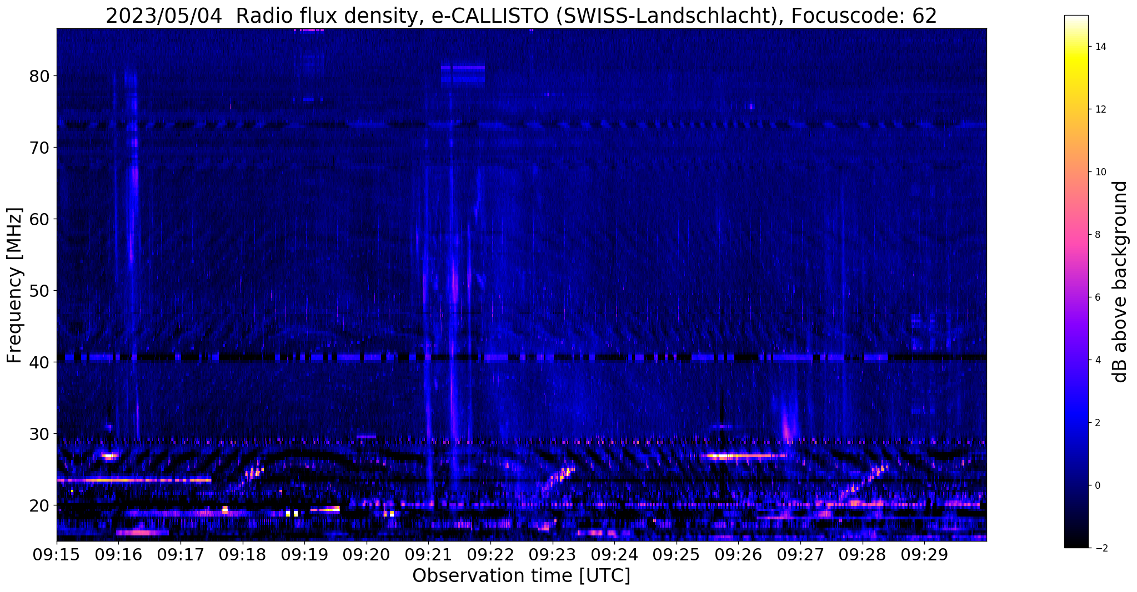
Evidence for another CME
Type II Burst?
The associated Type II burst is not strong.
No any X-Ray flare is observed
Another CME is appearing at the same location at 09:21 UT but not recorded in the SOHO catalog.
Notes:
38

Slide 39
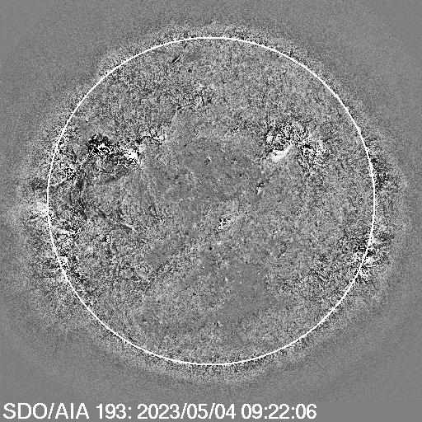
Evidence for another CME
Flare (121, 332)
(161 323 )
Flare 1
Flare 2

Slide 40
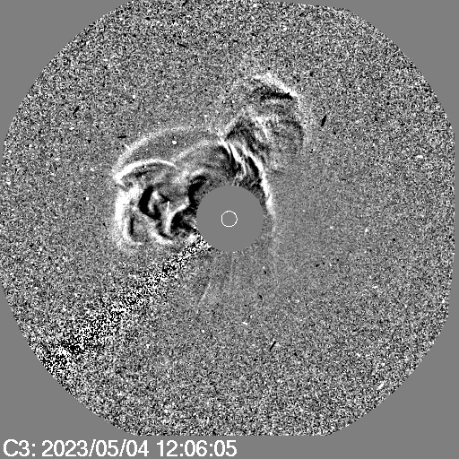
Appearance of the 2nd CME in LASCO C3
Shock 2
Shock 1
CME 2?

Slide 41
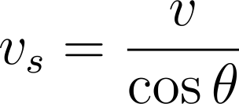
The CME Speed Analysis
$$v_{s}=1.1v_{LASCO}+156 km/s$$
(Gopalswamy et al 2015)
v_{s}
v
Therefore, our measured shock speeds and CME speeds lower than the actual values.

Slide 42
Interplanetary Type II Burst
Metric Type II 1
Metric Type II? 2
IP Type III
IP Type II

Slide 43
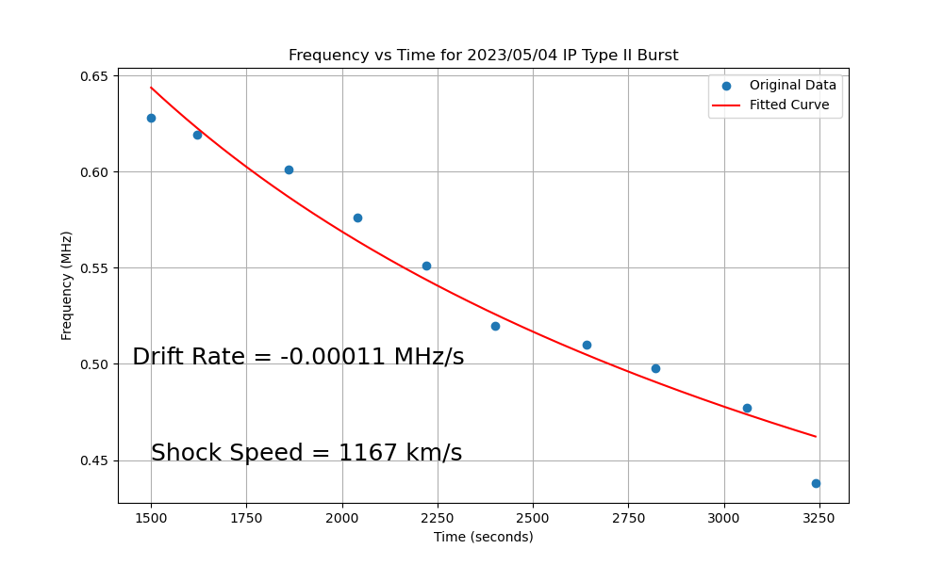
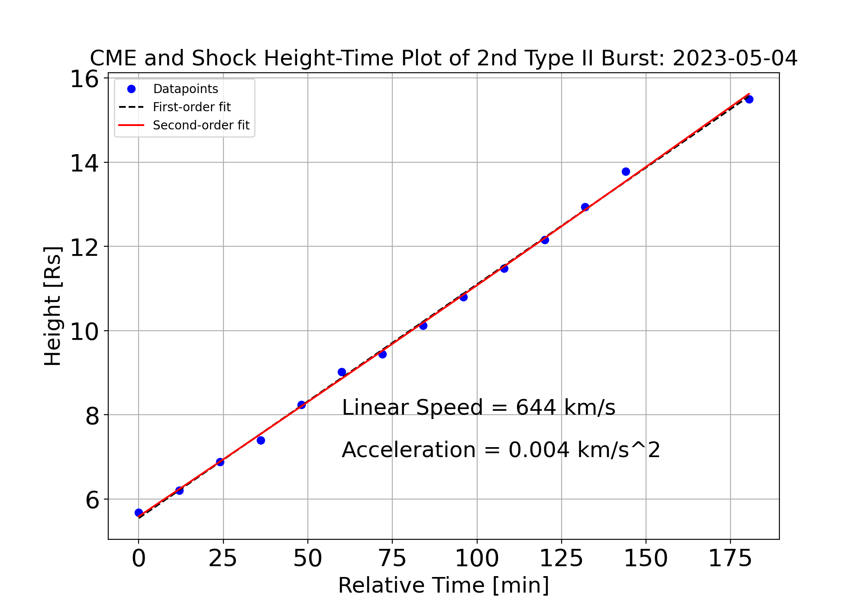
Shock Analysis For IP Type II Burst
$$v_{s}=1.1v_{LASCO}+156 km/s$$
The corrected speed is 864 km/s.
$$v_{s}=1.1×644+156=864 km/s$$
(Gopalswamy et al 2015)

Slide 44
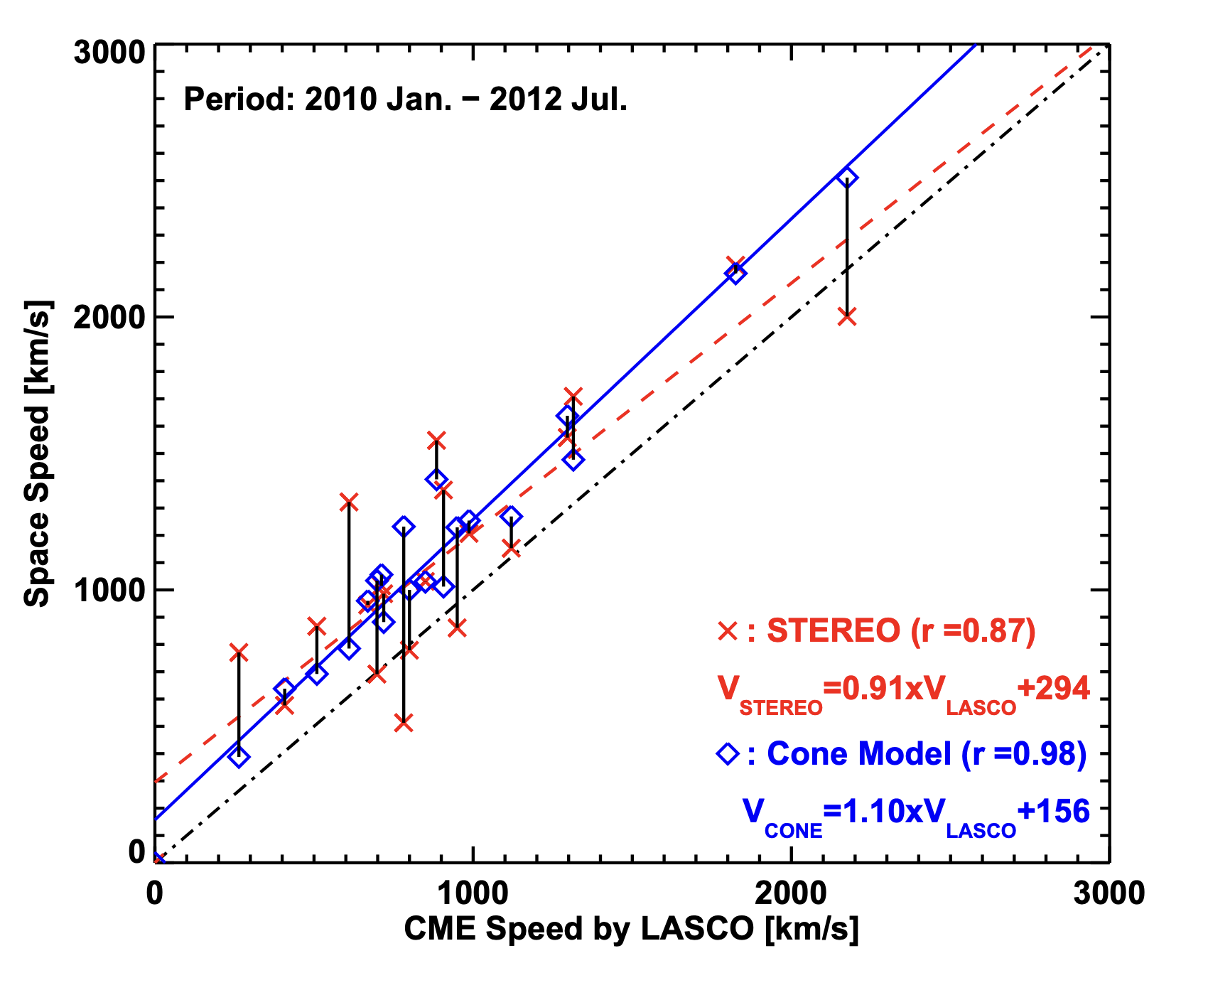
Shock Analysis For IP Type II Burst
The difference between and space speed and LASCO speed is 303 km/s and lie within the acceptable range.
Therefore, the shock speed calculation from the IP type II burst can be considered as a reasonable calculation.
(Gopalswamy et al. (2015))

Slide 45
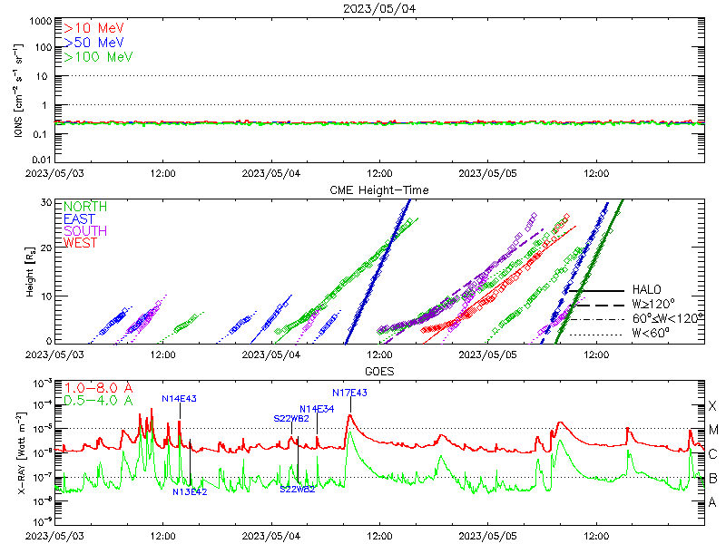
Associated SEP Events
No any SEP events observed.

Slide 46
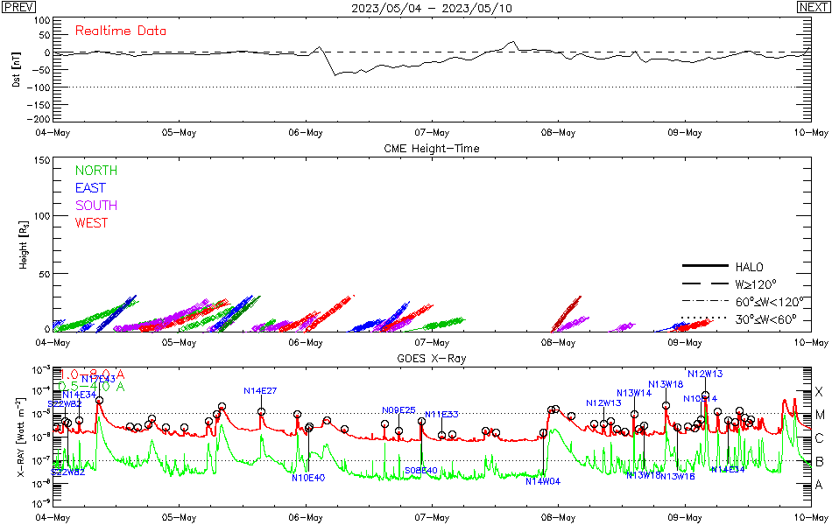
Geomagnetic Storms
Geomagnetic storm arriving time can we estimated by the following equation:
Geomagnetic Storm is possible after two or three days.
Where,
a = 151.002
b = 0.998625
c = 11.59
and V = 944 km/s from the SOHO catalog.
Therefore,
(N. Gopalswamy,2005)
Its nearly after 2 days and the geomagnetic storm is possible.

Slide 47
Conclusions – Event 2
There are 3 components in the event:
(i). Metric Type II with F, 2F and 3F
(ii). Faint Type II
(iii). Interplanetary Type II
There was a class M3.9 X-ray flare.
There are two CMEs at the same source location, but 2nd CME was not recorded.
Space speed and corrected CME speed consists with previous studies(Gopalswamy et al. 2015).
No any SEP event observed, but there is an indication of a geomagnetic storm after 2 days, that is possible due the ICME.
There was not any band splitting observed.

Slide 48
THANK YOU!

